Slide 1
NSX-T Ninja Week 3: Zilungele Cloud Services

Slide 2
Team
Brad Calvert
Alan M
Nicholas Schmidt
Jacob Shaw
Greg Worman
Alex Zorrilla

Slide 3
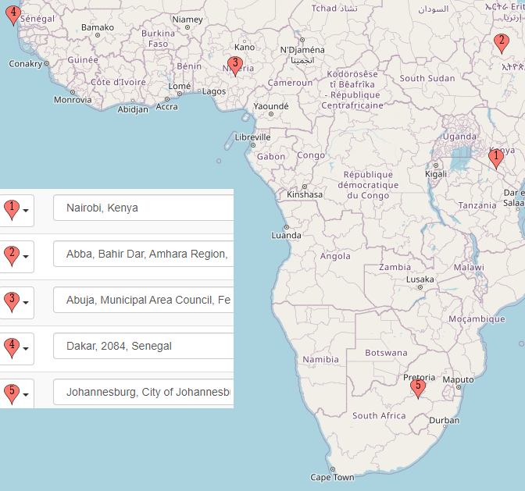
Background
Zilungele intends to extend its presence into Eastern and Western Africa with data centers in Nairobi, Kenya, Addis Abba, Ethiopia, Abuja, Nigeria & Dakar Senegal. ZCS plans to maximize their investment in the VMware Cloud Provider program by implementing an asset-heavy solution using the Cloud Provider Pod Stack. There will be 2 or more datacenters per city.
Introductory Tier
Intel white-box servers
Dual 16-core 2.4 GHz
128 GB RAM
Dual 10 Gb NIC
NFS Storage
Standard Tier – Shared IaaS Tenants
HP Synergy HCI Solution
Dual 24-core 2.4 GHz
512 GB RAM
Dual 25 Gb
Mellanox SH2200 Switch Module
Up to 640 TB per 12000 Chassis
Enhanced Tier – Dedicated IaaS Tenants
HP DL 360
Dual 16-core 2.8 GHz
128 GB RAM
Dual 25 Gb NIC
(4) 3.6 TB SSD
(2)1.2 TB SSD

Slide 4
Business Objectives
Multi-Tenant Resource Pooling
Common infrastructure supporting multi-tenant environment with heterogenous requirements
Container-as-a-Service
Fast K8s consumption across multiple AZ or Regions
Data Center Extension and Cloud Migration
Secure VM migrations and datacenter extensions
Multi-Site Management
Stretched datacenter across AZ or Regions, single pane of glass
Data Protection and Availability
DRaaS , Simple VM availability within a Region with cross-Region recovery
Notes:
Examples of Business Objectives for NSX, Architect please use the objectives of your case study
Faster and automated network and service provisioning
Simplified service insertion
Maximize hardware sharing across tenants
Increase business agility with easily implemented network services
Higher customer satisfaction for critical services
Improved environment sustainability
Increase networking intelligence in response to increased workload
Satisfy increased workload demands for public IP address assignment
Provide a way to analyze workload traffic
Minimize single points of failure
Protect workloads within a tenant’s segment

Slide 5
Technical Guiding Principles
Multi-Tenancy
~400 IaaS consumers, 2 year projection of ~800
~40 IaaS consumers w/ dedicated hardware, 2 year projection of ~80
~1500 projected tenant scale per CIO
Standard Tenant Sizing
~10 VMs per customer
Typically DaaS or 3-tier Web Apps
~4 vn-segments per customer
Probably high 80/20 N/S
Dedicated IPs per tenant - for IPsec L2L, and public services?
Dedicated Tenants
Can run own TZ, NSX-T Manager to reduce overhead on shared resources
Customers probably will not balk at costs for dedicated platform, as they're already paying it. Management WLD may require additional consideration.
Administrative Multi-Tenancy
Given that the customer tenant count exceeds reference scale for NSX-T RBAC, self-service is infeasible by direct appliance access. Fortunately, the customer already is using vCloud Director for this purpose, and their customers are already familiar with the platform.
All customer administrative changes SHOULD go through vCD, wherever possible.
Shared Services Tenant
Must interconnect to all ~430 customers with potentially overlapped addressing. Given that this number already exceeds scalability limits, a more "cloud-like" approach may be necessary here, like IPSec on A/P T0 in a shared service deployment
Probably needs public netblocks. See note about IPv6
Dataplane Multi-Tenancy
Availability Zones
Customer already has 2 AZs per region (city)
Each Availability zone will have A/A redundant components, including a shared services pod and network egress.
Public Cloud on-Ramp
Route-based L2L IPSec is an already established standard. Nick this may be feasible for infrastructure tenant universal access a la' transit gateways
Uptime SLA
99.99%
Scale
6,000 vn-segments
1,500 logical routers
Lots and lots of bulk crypto for the IPSec on/off ramp
Bridging
Do not bridge between network kinds wherever feasible, and constrain solutions doing so to their specific need or use case
IPv6
IPv6 should be used or usable wherever possible

Slide 6
Design Decisions
Decision | Justification | Risks | Alternatives | Notes
All regions must support all customers | Customers may need to make services available in different geographies | Scale limits | - | IPSEC VPN for each customer between regions they are in (self-provisioned via vCD)
VM mobility is permitted within a Region, but not between Regions | Links between AZ are high speed low latency, where inter-region links are higher latency and slower | Customer workloads need to be well-architected to take advantage of this | - | Professional services available
A city has multiple datacenters, each datacenter is an Availability Zone, and a city forms a Region | Increased availability and mobility | - | - | -
One NSX Manager Cluster per Region | Each Region will have stretched network and security objects | NSX Federation scale is too low for future growth | NSX Federation | -
Stretch Networks between AZs in a Region | Shared Networks and Security policy | - | - | -
T0-T0 Aggregation | To avoid constantly updating BGP Neighbor configurations | - | - | -
Tenant Isolation | Tenants will receive a dedicated T1 router, and use DFW and gateway firewall at their own discretion | - | - | Professional services available
VDI Placement will be on the same Transport Zone and have a dedicated vn segment on the customers T1 | Security is the responsibility of the customer within their tenancy | - | - | Professional services available
IPSEC Tunnel overlays | Customers using both environments need access between Tiers and customers may need access to each other | - | Route Everything and Microsegment, Route Reflectors | -
NSX Edge VMs sized at Large | Large VM supports up to 40 tenants with a load balancer and BFD not needed | Higher average cost per VM | Bare Metal Edges | Allows a standard hardware form-factor for Edge hypervisors
Manage tenant to infrastructure ration in a scalable and maintainable way | - | - | - | Keep Edge Transport Node to tenant ratios low where possible

Slide 7
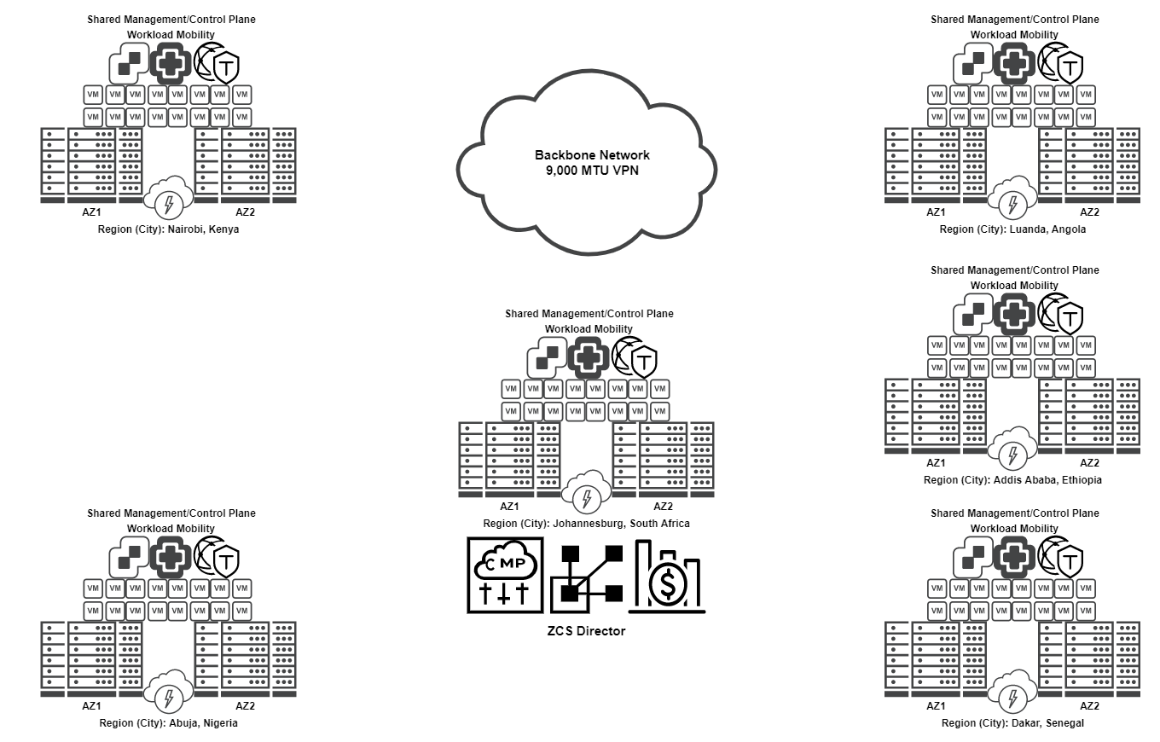
Infrastructure Overview

Slide 8
ZCS Director
Overview
VMware vCloud Director allows us to convert our physical data centers into virtual data centers (VDCs). By placing network, storage and compute resources, into VDC resources, we can then make them available as catalog-based services to customers through a web portal.
VMware vCloud Director will be used as a subcomponent of the Cloud Provider Pod for applying limits on customers to control access and the consumption and will be initially located in the Johannesburg Region.
Consumable Services
In-Scope
IaaS Tenancy will follow the Routed (Shared T0) on-demand blueprint model provided natively with vCD
Dedicated Tenancy will follow the Routed (Dedicated T0) on-demand blueprint model provided natively with vCD
Shared Services hub will be natively deployed following leveraging the following service catalog items provided natively with vCD under the Provider VDC:
Routed (Dedicated T0)
Shared Services vApp will require some additional development with long-term benefits
This is to maximize the repeatability of the shared services hub, which SHOULD be implemented in every Availability Zone
CaaS. Containers-as-a-Service will be provided, but as its own service under a standalone `Routed (Shared T0`)
Out-of-Scope
External Networks.
Desktop-as-a-Service
Highly customised CaaS

Slide 9
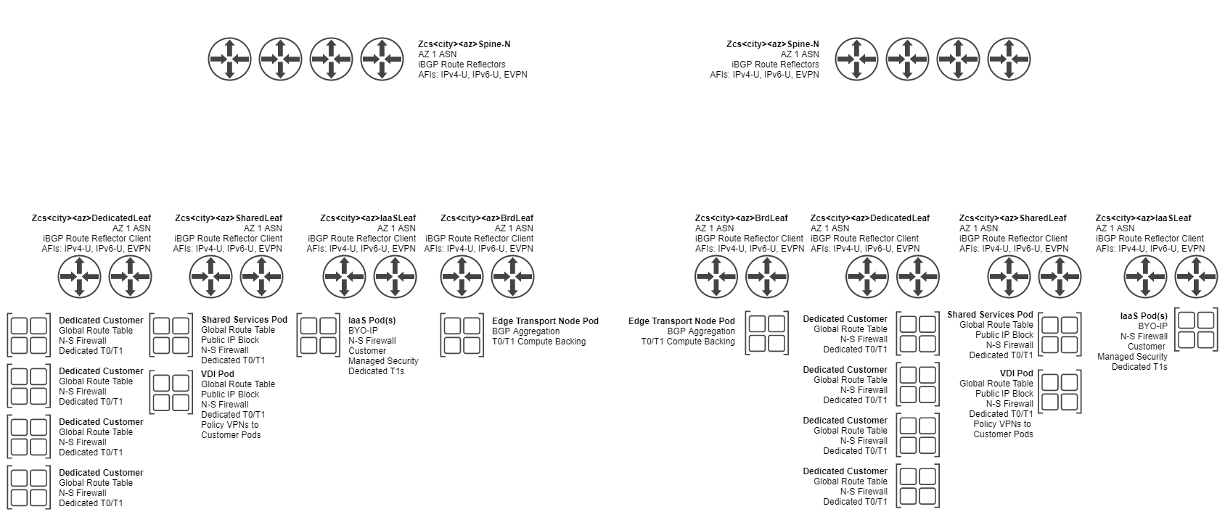
Regional Infrastructure

Slide 10
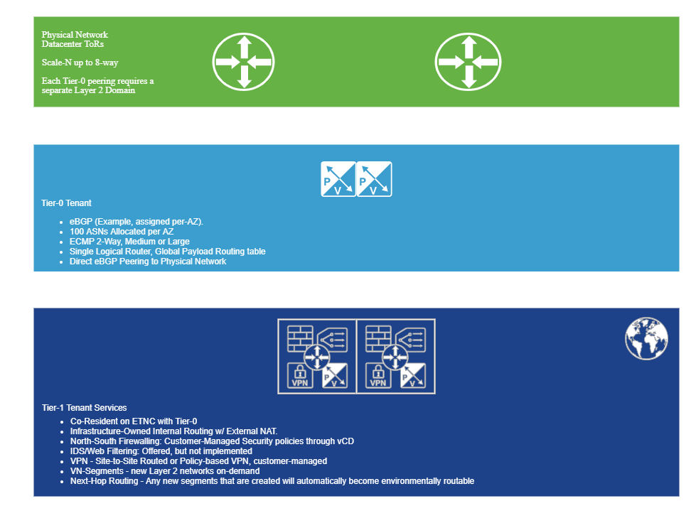
HLD Dedicated Tenant

Slide 11
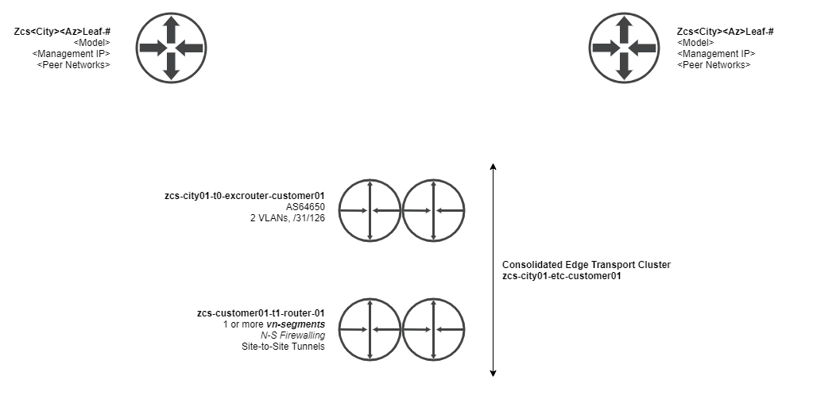
Dedicated Tenant Routing
Dedicated tenants require dedicated T0

Slide 12
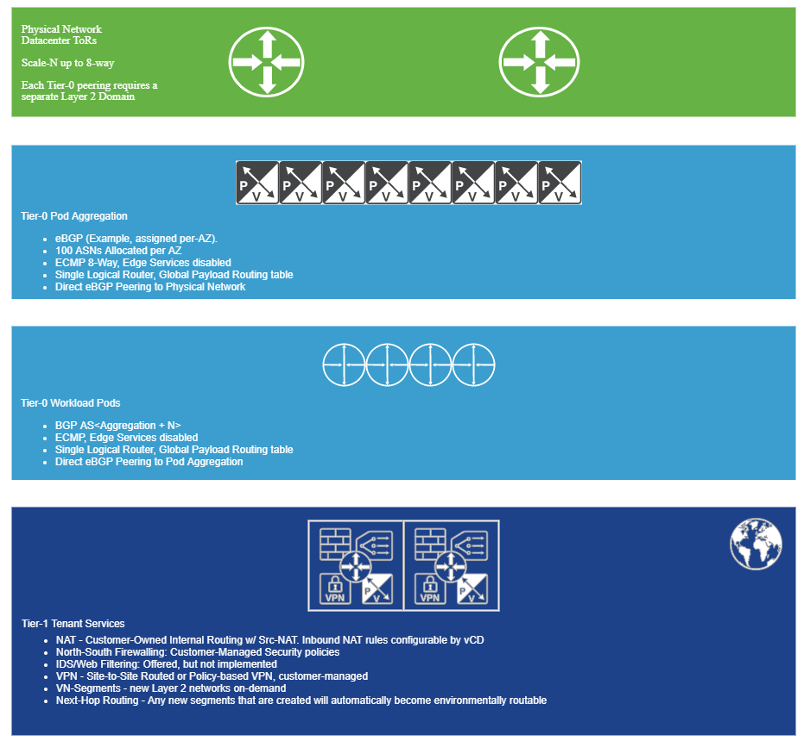
HLD IaaS Tenant

Slide 13
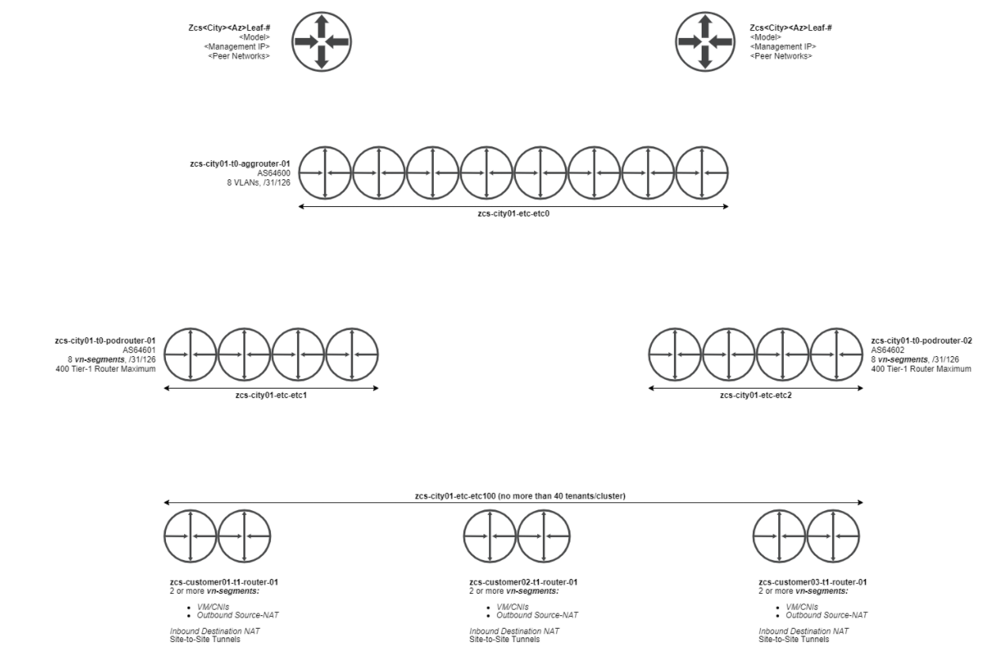
IaaS Tenant Logical Routing

Slide 14
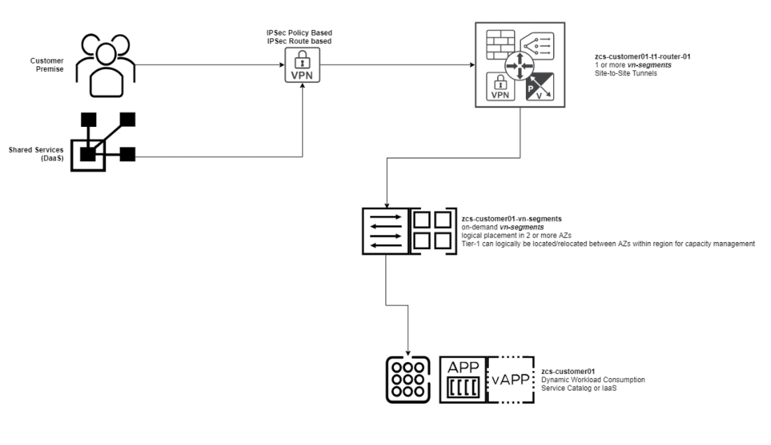
IaaS / Dedicated T1 Services

Slide 15
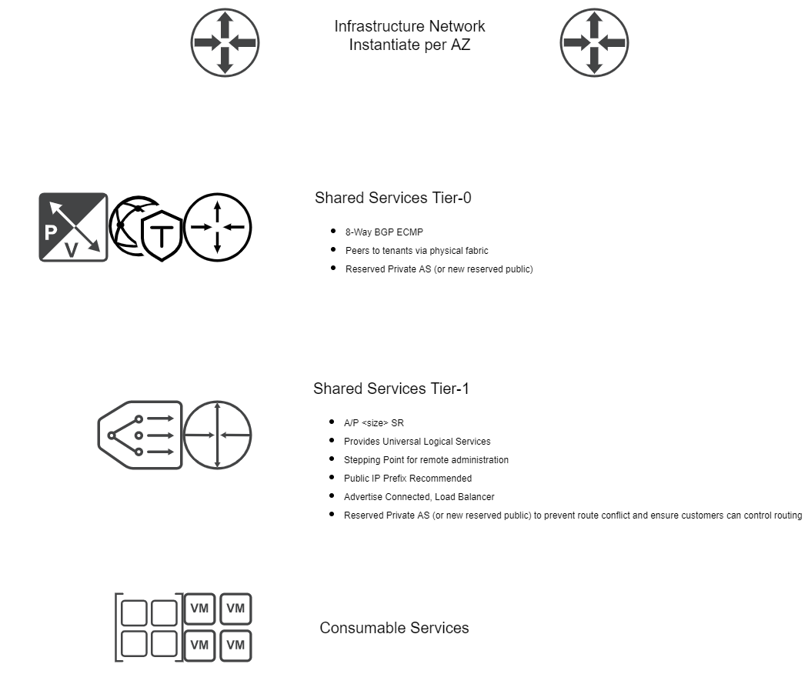
Shared Services

Slide 16
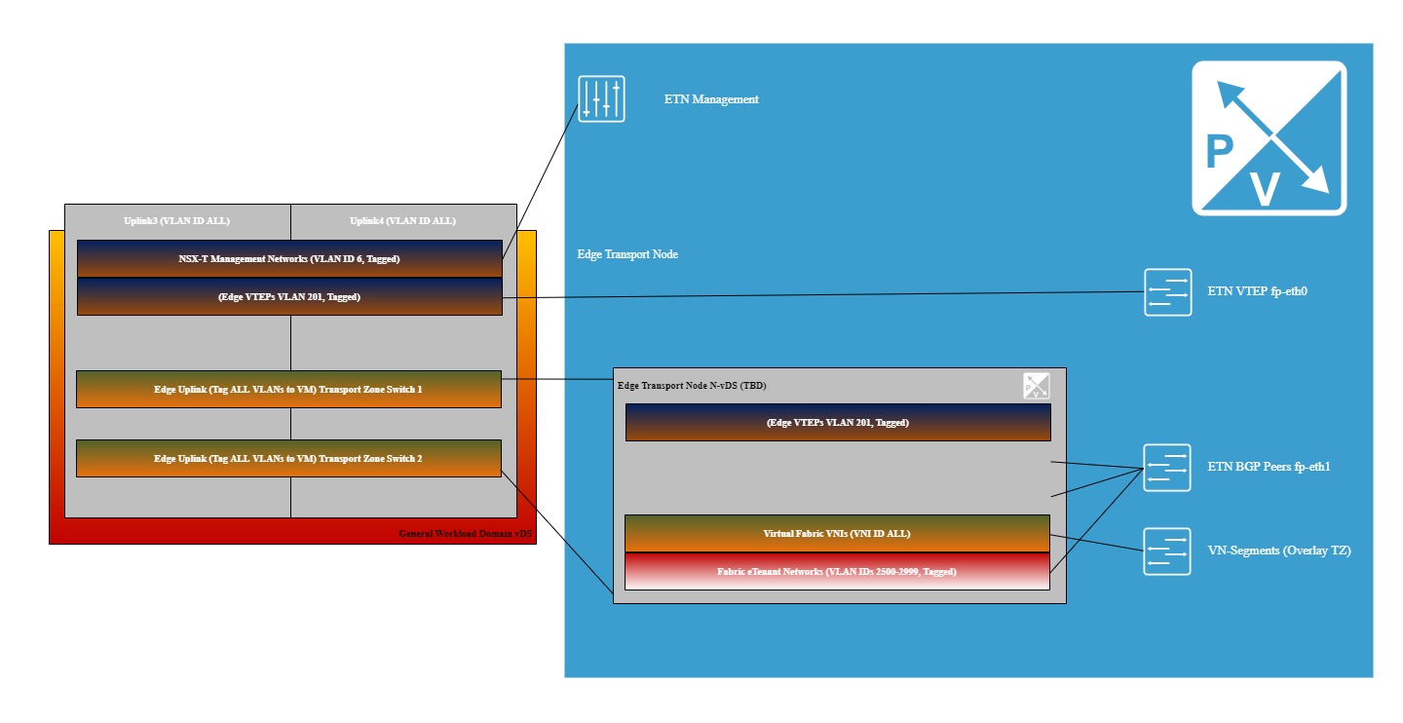
Edge Transport VDS

Slide 17
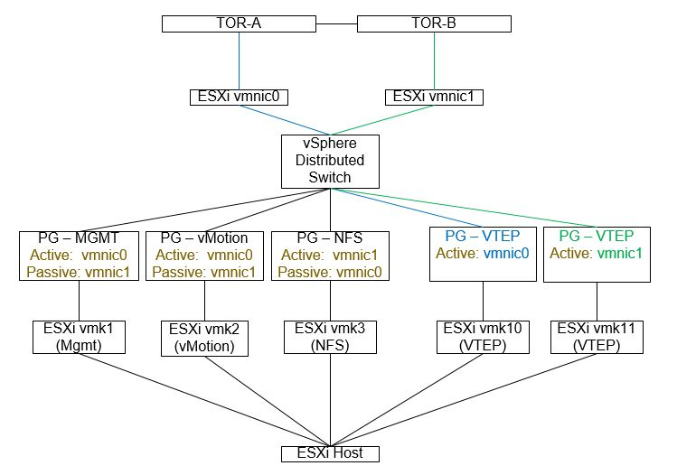
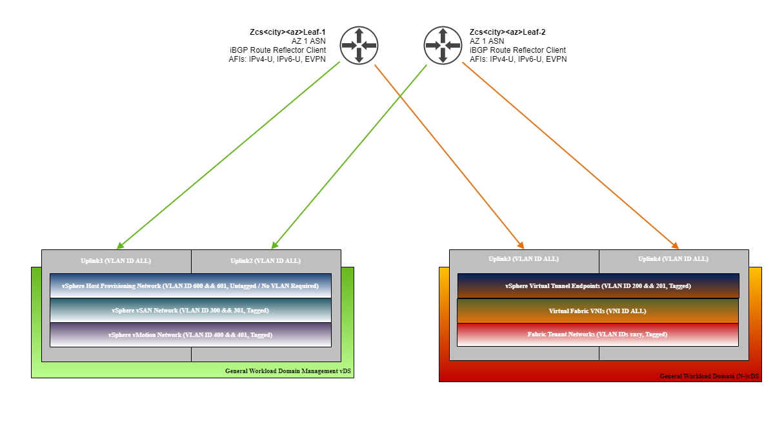
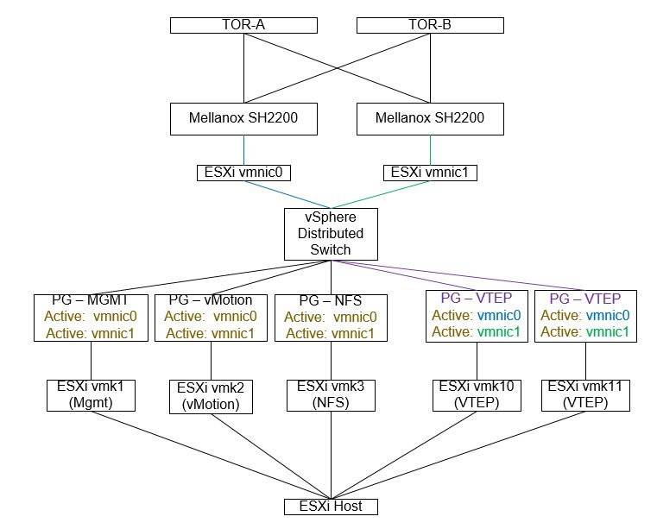
Transport VDS
Introductory Tier Transport
If hardware was recommended - 4pNICs
Enhanced Tier Transport

Slide 18
Shared Responsibility Security Model
To provide scalable, cost-effective infrastructure, the "Service Provider" Zilungele Cloud Services must provide a clear-cut outline indicating where security responsibilities exist.
Service Provider Responsibilities
The "Service Provider" WILL retail ultimate responsibility for the security of:
Cloud Management Platforms, e.g. vCloud Director Cells
IaaS Components, e.g. VMware Cloud Provider Pod or VMware Cloud Foundations
Identity and Access Management for CMP/IaaS
Hypervisors and Bare Metal Compute
Storage Platforms
Physical Facilities
Inter-Availability Zone Backbone Networks
Inter-Region Availability Zone Backbone Networks
Tenant Network Separation
Regional facilities and Availability Zones
Customer Responsibilities
The "Customer" WILL retail ultimate responsibility for the security of:
Application Security
Placement of workloads to best achieve Availability goals
Guest Operating System Security
Confidentiality for Data stored in ZCS
Confidentiality for Data in transit
Network Security within the Tenant network, and any interconnection thereof
Identity and Access Management within the Tenant

Slide 19
Firewall Rules
North/South
Infrastructure
Policy | Action | Services | Source | Destination | Applied To
Common Services | Allow | GROUP-COMMON-SERVICES | Any | 240.0.128.0/18 | This Gateway
Environment
Policy | Action | Services | Source | Destination | Applied To
Tenant#### | Deny | All | Tenant#### | Other Tenants | Tenant###
Dynamic Tag Membership
Tenant#### Tag
East/West
Tenant defined via vRA/vRO
Emergency/Infrastructure/Environment/Application
Policy | Action | Services | Source | Destination | Applied To
Tenant self-defined via vRA/vRO | User Defined | User Defined | Tenant#### | User Defined | Tenant####

Slide 20
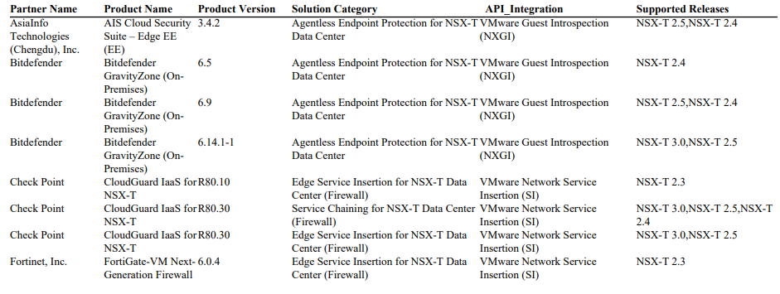
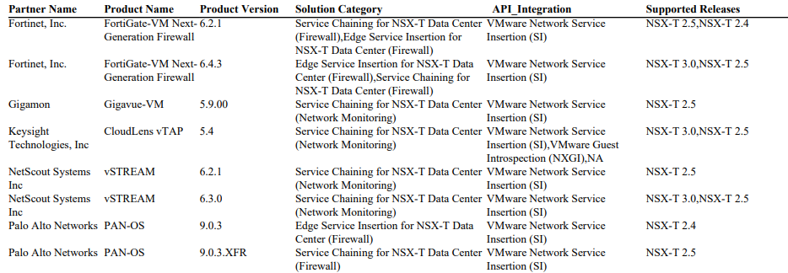
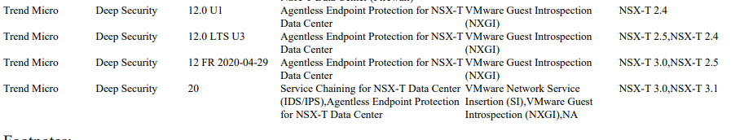
Guest & Network Introspection Vendors

